Slide 1

Notes:
React Native lets you build mobile apps using only JavaScript. It uses the same design as React
Beta version 0.39,
Live reloading,
Chrome debug
Use any IDE you want
IOS easy publish

Slide 2
LEARN ONCE,
WRITE ANYWHERE
Notes:
Compile to IOS and Android from same codebase,
Write in JS or any langauge that compiles to javascript

Slide 3
Cross platform code reuse

Slide 4
Web view vs Native view
Notes:
We want user expireiance of native and web expirence of developer
Phone Gap and Cordova
some apps can be developed in web but they never feel the same
FlexBox layout system, familiar + readable

Slide 5
How it works
JavaScript
Native
Bridge

Slide 6
Web Vs. React-Native
<div> | <Text> <View>
css | css like objects
Flexbox (default row) | FlexBox (default column)
Class & Id | None
Notes:
alignItems defaulting to stretch instead of flex-start

Slide 7
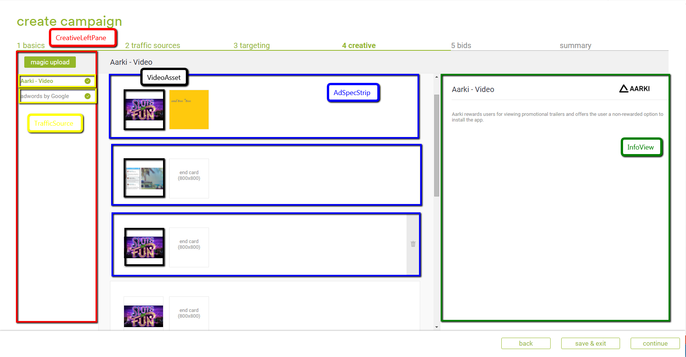
Components

Slide 8
Code Example
export default class FirstApp extends Component {
render() {
return (
<View style={styles.container}>
<Text style={styles.welcome}>
Welcome to React Native!
</Text>
<Text style={styles.instructions}>
To get started, edit index.android.js
</Text>
<Text style={styles.instructions}>
Double tap R on your keyboard to reload,{'\n'}
Shake or press menu button for dev menu
</Text>
</View>
);
}
}

Slide 9
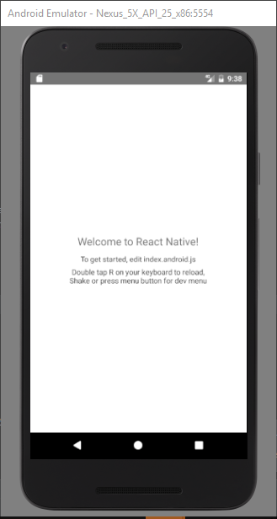

Slide 10
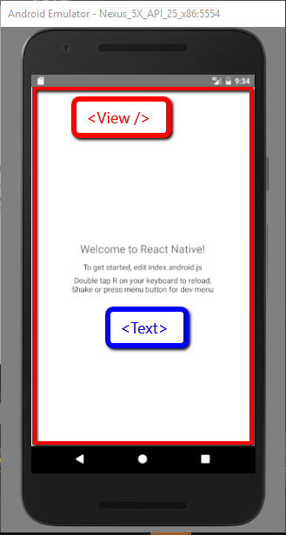

Slide 11
Styles Example
const styles = StyleSheet.create({
container: {
flex: 1,
justifyContent: 'center',
alignItems: 'center',
backgroundColor: 'red',
},
welcome: {
fontSize: 20,
textAlign: 'center',
margin: 10,
},
instructions: {
textAlign: 'center',
color: '#333333',
marginBottom: 5,
}
});

Slide 12
App Demo

Slide 13
Questions?

